Slide 1


Slide 2


Devnet Module 3
Software Development and Design

Slide 3

Module Objectives
Topic Title | Objectives
Software Development | Compare software development methodologies.
Software Design Patterns | Describe the benefits of various software design patterns.
Version Control Systems | Implement software version control using GIT.
Coding Basics | Explain coding best practices.
Code Review and Testing | Explain coding best practices.
Understanding Data Formats | Use Python to parse different messaging and data formats.
Use software development and design best practices.

Slide 4

Software Development

Slide 5

Software Development Process
The Software Development Process (SDP), also known as the Software Development Life Cycle (SDLC), is a framework to facilitate software creation.
SDLC guides the development of software from its conceptualization to delivery. This process is delineated into six phases, each taking the results of the preceding phase as input.
SDLC is more than just coding and delivery; it involves the gathering requirements, planning, controlled execution, testing, and bug resolution.

Slide 6
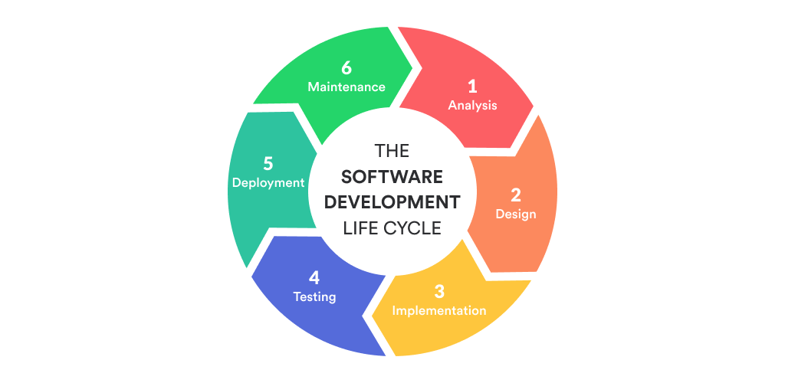
Software Development Life Cycle

Slide 7
Requirements and Analysis Phase
During the requirements and analysis phase, the team explores the stakeholders' current situation, assessing their needs, constraints, and existing infrastructure, to identify the specific problem the software aims to solve.
Following the collection of these requirements, the team analyzes the findings to answer several critical questions:
Can the software be developed according to these requirements while adhering to the budget?
Are there identifiable risks to the development schedule, and if so, what are they?
What strategies will be employed for software testing?
What are the timelines for software delivery, and through what means will it be delivered?
After this phase, the classic waterfall method dictates the creation of a Software Requirement Specification (SRS) document. This document, which outlines the software’s scope and requirements, is then rigorously reviewed and confirmed with stakeholders to ensure alignment and clarity on the project directives.

Slide 8
Design and Implementation Phases
Design Phase
In the Design phase, software architects and developers devise the software structure using the guidelines stipulated in the SRS document.
As this phase concludes, the team compiles two critical documents to illustrate the design details: the High-Level Design (HLD) and the Low-Level Design (LLD) documents.
Implementation Phase
The implementation phase, also known as the coding or development phase, involves the construction of individual components and modules, making it the longest stage in the life cycle.
As this phase concludes, a functional code, which encapsulates all of the customer’s requirements, is prepared and ready for testing.

Slide 9
Testing and Deployment Phases
Testing Phase
In this phase, the code is deployed in a test environment where various testing methods, including functional, integration, performance, and security testing, are performed to evaluate the software's readiness.
Testing persists until all code segments are bug-free and have successfully passed all evaluations. Upon completion of this phase, a high-quality, bug-free, functional piece of software is prepared for production deployment.
Deployment Phase
In this phase, the software is installed into the production environment, marking its readiness for official release.
As the phase concludes, the product manager orchestrates the release of the final version of the software to end users, signaling the software's transition from development to real-world application.

Slide 10
Maintenance Phase
During the maintenance phase, the team engages in a series of crucial activities to ensure that the software continues to meet user needs efficiently and effectively.
Customer Support: The team provides ongoing support to customers, helping them with any issues or questions that may arise, ensuring a seamless user experience.
Bug Fixes: Identified bugs in production are promptly addressed to maintain the stability and reliability of the software.
Software Improvements: The team proactively works on implementing improvements, many of which are identified through user feedback.
Gathering New Requests: New requests and ideas from customers are collected and evaluated for possible inclusion in future software updates, ensuring that the product evolves in line with user needs.
At the end of this phase, all the accumulated learning and feedback are used to plan and develop the next iteration and version of the software, marking the onset of a new cycle of development focused on innovation and continual enhancement.

Slide 11
Software Development Methodologies
A Software Development Methodology is a conceptual framework used to structure, plan, and control the process of developing an information system. There are several methodologies that are widely adopted in the industry, each with its own unique approach and focus. The three most popular methodologies are:
Waterfall: This methodology follows a linear and sequential approach, where each phase must be completed before moving on to the next. It's quite rigid but allows for meticulous documentation at each stage.
Agile: A more flexible approach where the project is divided into small increments with minimal planning. It promotes collaborative effort including customer as a stakeholder in the development process.
Lean: Inspired by lean manufacturing principles, it focuses on delivering a product with high value while eliminating wasteful practices. It strives for efficiency and optimal performance.

Slide 12
Software Development Methodologies
When deciding on a methodology, it is essential to consider various factors to choose the best fit for your project. These include:
Type of the project: Different projects may require different approaches. For instance, a complex project might benefit from the structured approach of Waterfall, while a project with changing requirements might be better suited for Agile.
Length of the project: Short-term projects might be more aligned with Agile or Lean methodologies, while long-term projects might benefit from the Waterfall methodology.
Size of the team: Larger teams might find structured methodologies like Waterfall beneficial, while smaller teams might prefer the flexibility of Agile or Lean.
Selecting the right methodology is crucial for the successful development of a software project. It helps in structuring the workflow in a way that leverages the strengths of the team while mitigating potential risks, ensuring the project’s success and efficiency.

Slide 13
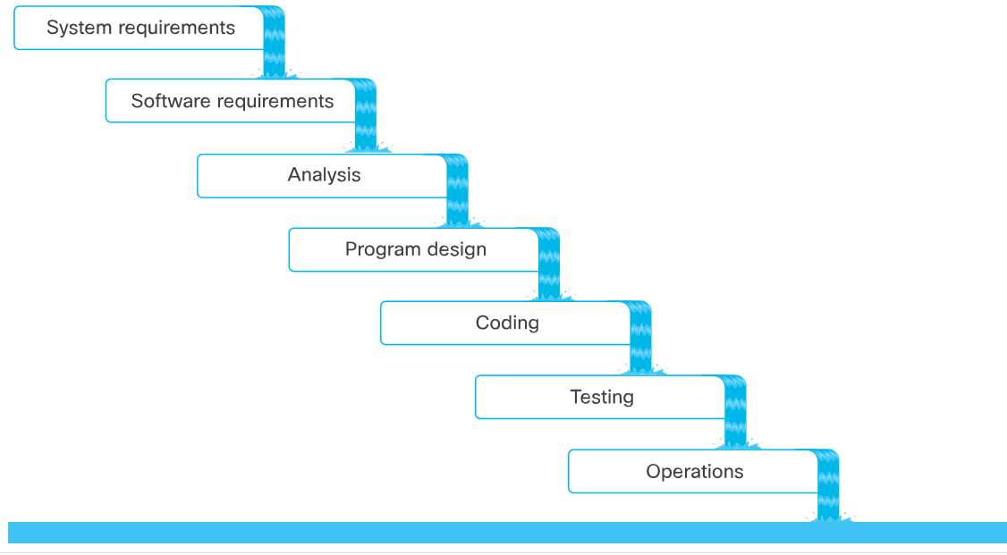
Waterfall Software Development
The original waterfall model was created by Winston W. Royce in the 1970s.
The original model has a structured linear sequence of seven distinct phases.
Each phase must be completed before moving on to the next.

Slide 14
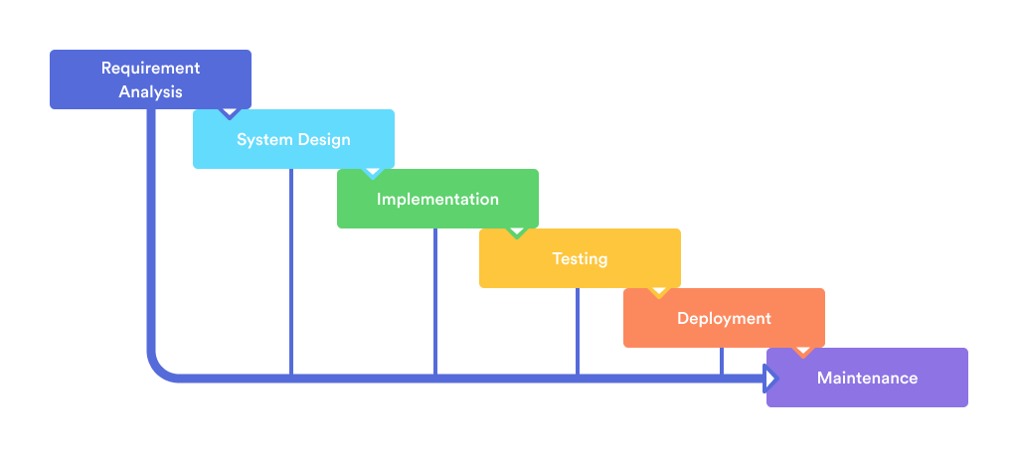
Waterfall Software Development
Fonte: MLSDev

Slide 15
Waterfall Software Development
Merits of Waterfall Project Management
Predictability and Planning: The methodology outlines a clearly defined path for the project, offering team members insight into future steps and allowing them to plan their schedules accordingly.
Cost Estimation: It facilitates the determination of the project's overall cost before initiation.
Progress Measurement: The structured nature of the approach means that progress can be easily tracked at any stage of the project.
Ease of Integration for Late Joiners: New team members can integrate smoothly, understanding and picking up their designated tasks without hassle.

Slide 16
Waterfall Software Development
Demerits of Waterfall Project Management
Extended Completion Time: The project timeline tends to be longer compared to more agile methodologies. Time is the enemy when it comes to delivering value.
Delay Cascade: A delay in one phase invariably leads to subsequent delays in the following phases, creating a cascading effect.
Limited Client Engagement: Clients have minimal involvement during the implementation stages, which can sometimes lead to a gap between client expectations and the final deliverable.

Slide 17
Agile Software Development
The Agile method, known for its flexibility and customer-centric approach, originated from the Agile Manifesto, which was conceived by a group of 17 software developers in 2001.
The manifesto emphasizes four core values:
Prioritizing individuals and interactions over processes and tools
Valuing working software over comprehensive documentation
Focusing on customer collaboration over contract negotiation
Being adaptive and responding to change over strictly following a plan
These values underscore the Agile method's adaptability and commitment to delivering value and satisfying the customer's needs.

Slide 18
Agile Software Development
The 12 principles of the Agile Manifesto
These principles are fundamental to understanding and implementing agile software development and help guide teams in delivering high-quality products efficiently and collaboratively.
Customer Satisfaction | Collaboration | Working Software | Simplicity
Welcoming Change | Motivated Individuals | Sustainable Development | Self-Organizing Teams
Frequent Delivery | Face-to-Face Communication | Technical Excellence | Regular Reflection and Adjustment

Slide 19
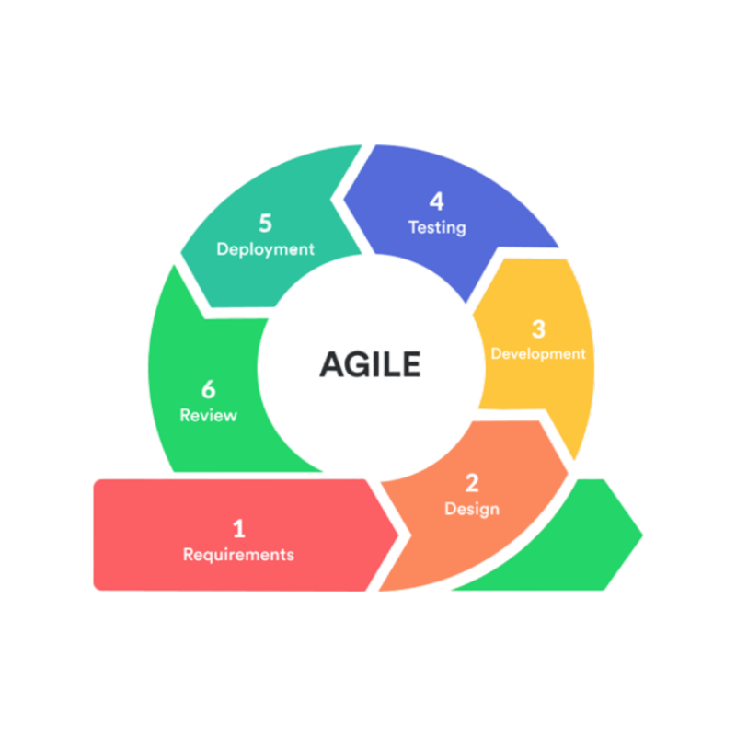
Agile Software Development
Fonte: MLSDev

Slide 20
Agile Software Development
Popular Agile methods include:
Scrum: Focused on small, self-organizing teams working in sprints with daily stand-up meetings to discuss progress and obstacles.
Lean: Aims to eliminate waste and improve efficiency through continuous feedback and process refinement.
Extreme Programming (XP): Addresses quality-of-life issues for development teams with practices like pair programming and continuous integration.
Feature-Driven Development (FDD): Involves systematic building through an overall model, developed feature-by-feature.
Test-Driven Development (TDD): Prioritizes writing tests before the actual code, ensuring comprehensive test coverage and higher code quality.
Each of these methodologies brings unique practices and principles, aimed at fostering collaboration, adaptability, and delivering high-quality software.

Slide 21
Agile Software Development – Scrum
1. Sprints:
Is a specific period, typically between 2-4 weeks.
Team commits to completing user stories.
Results in a potentially shippable product increment.
Sprint duration is pre-determined and rarely changes.
2. Backlog:
Comprises all software features, listed in priority order.
Serves as the source for sprint planning.

Slide 22
Agile Software Development – Scrum
3. User Stories:
Define what a user or role requires and why.
Each story should be small enough for completion within a single sprint.
Suggested Template:
"As a <user|role>, I would like to <action>, so that <value|benefit>."
4. Scrum Teams:
Cross-functional, collaborative, self-managing, and self-empowered.
Typically no larger than 11 members:
Nine Developer
Product Owner – PO
Scrum Master - SM

Slide 23
Agile Software Development – Lean
Originating from Lean Manufacturing, which was developed by Toyota in the late 1940s to early 1950s, Lean Software Development was introduced in 2003 and is focused on minimizing waste and maximizing value to the customer.
The methodology is underscored by seven principles outlined in the book “Lean Software Development: An Agile Toolkit”:
Eliminate Waste
Amplify Learning
Decide as Late as Possible
Deliver as Fast as Possible
Empower the Team
Build Integrity In
Optimize the Whole

Slide 24
Agile Software Development – Lean
Eliminate Waste: Central to Lean principles, focusing on eradicating the seven wastes of software development:
Partially Done Work: Incomplete work by the end of a cycle is wasteful, requiring extra effort to continue.
Extra Processes: Unnecessary processes that don’t add value to the product consume time and resources.
Extra Features: Features not required by the customer increase complexity and waste resources.
Task Switching: Frequently changing tasks reduces efficiency and increases the risk of errors.
Waiting: Delays in the development process, like waiting for approvals, lead to idle time.
Motion: Unnecessary movements by the team, such as searching for information.
Defects: Errors or bugs require additional time to fix, leading to delays and reduced quality.
Eliminating these wastes leads to a more efficient development process, maximizing value and minimizing waste.

Slide 25
Agile Software Development – Lean
Amplify Learning: Advocates for short and iterative sprints of working software, enabling continuous learning and adapting. This principle helps in fine-tuning the software according to evolving needs, aiming the following:
Developer Learning
Accelerate Customer Feedback
Adjust Features for Increased Value.
Decide as Late as Possible: Encourages delaying decisions in the face of uncertainty, advocating for decisions based on facts rather than opinions or speculations.
Deliver as Fast as Possible: Aims for quick deliveries, delivery of customers' required features, enabling fast customer feedback, amplified learning for developers, expedited decision-making, and waste reduction.

Slide 26
Agile Software Development – Lean
Empower the Team: Endorses individual decision-making within one’s area of expertise.
Build Integrity In: Strives for software integrity by addressing customer needs and maintaining its usefulness over time.
Optimize the Whole: Ensures cohesive software development, with each expert considering the impact of their decisions on the overall software.

Slide 27
Agile Software Development – Lab
LAB 1 – Demonstration of Artifacts and Diagrams using ACI
LAB 2 - Tools for Supporting Software Development
Tool: Monday Dev
Project: Enable Python Lab
User Story 1: Review the Python Installation
User Story 2: PIP and Python Virtual Environments
User Story 3: Sharing Your Virtual

Slide 28
Software Design Patterns

Slide 29
Introduction
Software design patterns are best-practice solutions to common problems in software design. They are language-independent strategies. In 1994, the “Gang of Four” - Erich Gamma, Richard Helm, Ralph Johnson, and John Vlissides - published the book “Design Patterns: Elements of Reusable Object-Oriented Software,” cataloging 23 classic patterns.
Key Principles:
Program to an interface, not an implementation.
Favor object composition over class inheritance.
Benefits:
Proven Success: Patterns are tried-and-tested paradigms.
Efficiency: Facilitate code reuse and maintainability.
Speed: Accelerate the development process by providing reliable structuring methods.
Utilizing design patterns leads to more modular, flexible, and adaptable software.

Slide 30
Introduction
The Gang of Four classified the design patterns into three main categories:
Creational: Concerned with the process of object creation.
Structural: Concerned with the composition of classes or objects.
Behavioral: Concerned with object collaboration and delegation of responsibility.
They listed a total of 23 design patterns in these categories, providing a diverse toolkit for software design.
Commonly Used Patterns:
Observer Design Pattern: A Behavioral design pattern focusing on a subject-observer relationship for event handling.
Model-View-Controller (MVC): A pattern widely used for developing user interfaces that divides the related program logic into three interconnected components.
These patterns have found widespread use, aiding developers in creating maintainable, scalable, and robust software solutions.

Slide 31
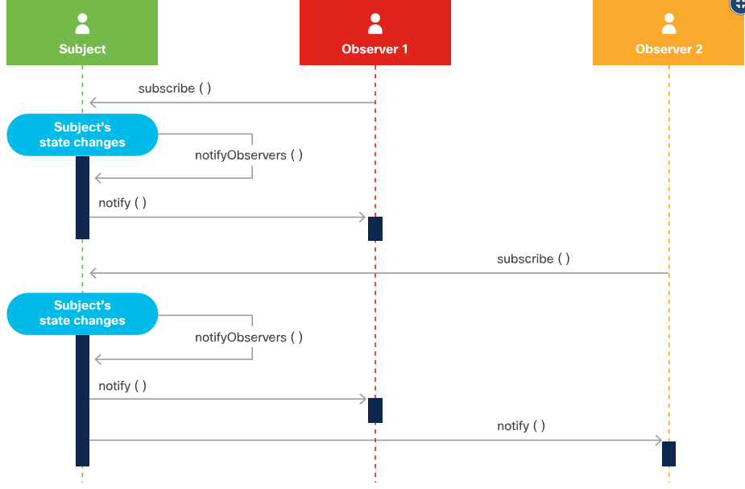
Observer Design Pattern
This pattern is a subscription-notification design allowing objects to receive events when changes occur to an object they are observing.
Implementation:
The subject needs the ability to store a list of all its observers.
The subject requires methods to add and remove observers.
Benefits:
Observers receive real-time data from the subject upon any changes.
This subscription mechanism offers superior performance compared to alternatives like polling.
It’s advantageous for scenarios where timely and efficient updates are crucial for the observer objects.

Slide 32
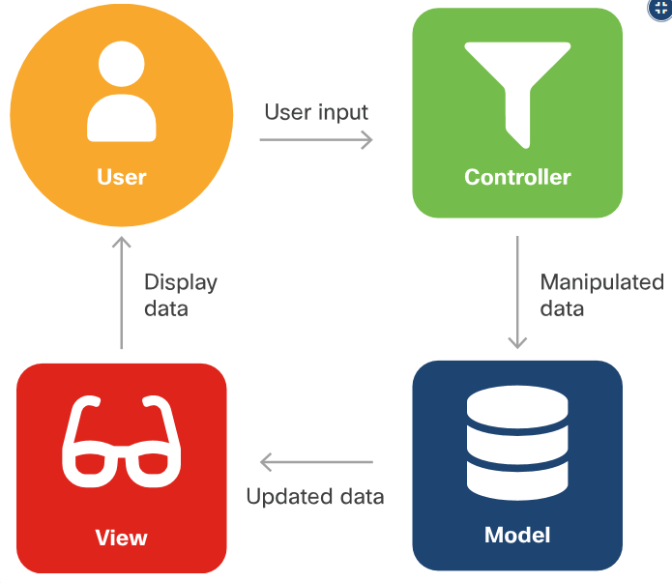
Model-View-Controller – MVP
This design pattern is aimed at simplifying the development of applications, particularly those with graphic user interfaces.
Components:
Model: Manages data, logic, and rules of the application. Receives input from the controller.
View: Represents the visual presentation of the data.
Controller: Acts as a middleman between the model and view, manipulating user input to fit the required format.
Allows for parallel development of components, enhancing development efficiency and maintainability.
MVC is particularly beneficial in applications where separation of concerns and modular development are essential.

Slide 33
Version Control Systems

Slide 34
Types of Version Control Systems
Version control, also known as version control systems, revision control, or source control, is a system for managing changes to a set of files, enabling the retention of a history of these changes.
Benefits of Version Control:
Enables Collaboration: Allows multiple developers to work on a project simultaneously.
Accountability and Visibility: Tracks changes and identifies who made them, providing transparency.
Work in Isolation: Developers can make changes in isolated environments to avoid conflicts.
Safety: Prevents loss of work and facilitates reverting to previous versions.
Work Anywhere: Access and contribute to projects from different locations.
Types of Version Control Systems:
Local: Version control operated on a local system.
Centralized: A single server hosts the version-controlled files, and developers check out files to their local system.
Distributed: Every contributor has access to the full repository and its history on their local machine.

Slide 35
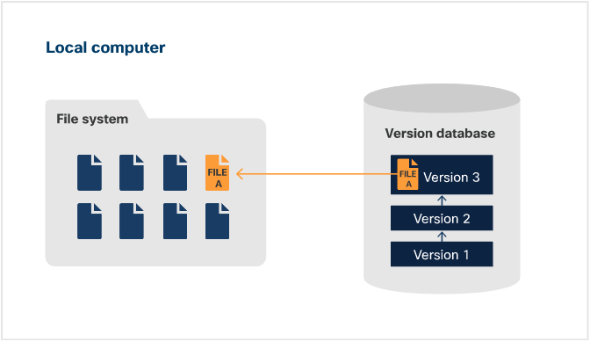
Local Version Control System
Local Version Control System utilizes a simple database to monitor all alterations made to files, primarily operating on the user’s local machine.
How it Works:
The system typically stores the difference (delta) between successive versions of a file.
When reverting to a previous file version, the stored delta is applied in reverse to achieve the desired state.
Key Characteristics:
Simplicity: Straightforward and easy to use, ideal for individual projects.
Local Access: All version

Slide 36
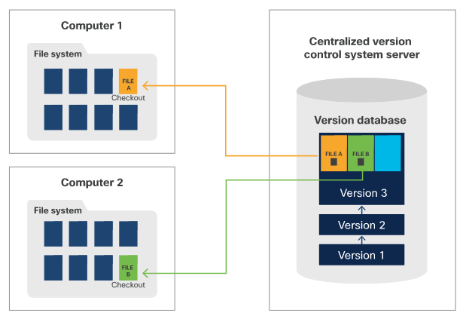
Centralized Version Control System
Centralized Version Control System operates on a server-client model, with the repository hosted on a central server.
How it Works:
All project files are stored centrally, allowing for easier collaboration.
Only one individual can work on a specific file at a time. Users must check out the file to lock it, make the required changes, and check it back in once done.
Key Characteristics:
Central Management: Simplified administration and control through a single repository.
Collaboration: Facilitates teamwork but with constraints on concurrent file modifications.

Slide 37
Distributed Version Control System
Distributed Version Control System operates on a peer-to-peer model, allowing repositories to be stored on client systems or hosting services.
How it Works:
Every user has access to the entire repository and history, enabling simultaneous work on any file.
Changes are made to local files in the working copy, eliminating the need for locking.
After modifications, users push the file to the main repository on the hosting service.
The system detects and manages any conflicts between concurrent file changes.
Key Characteristics:
Decentralized: Enhanced collaboration with repositories distributed across users.
Conflict Management: Efficient handling of modifications made by different users.

Slide 38
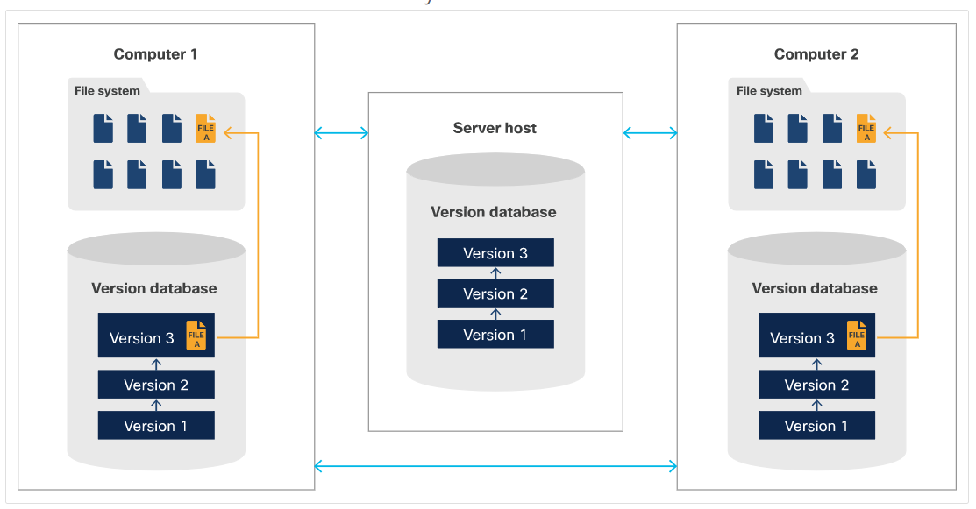
Distributed Version Control System

Slide 39
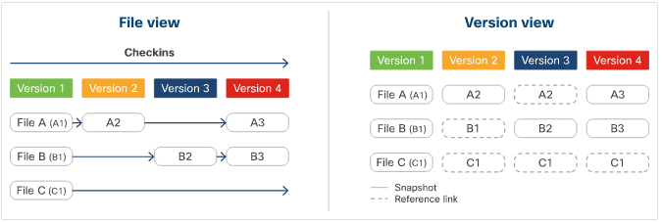
Git
Git is a popular, open-source implementation of a distributed version control system, widely used in modern software development.
Available for MacOS, Windows, and Linux/Unix and requires a Git client installed on the client machine.
Key Features:
Snapshot Storage: Unlike other systems storing data as differences (delta), Git stores data as snapshots.
Reference Linking: If a file remains unchanged, Git creates a reference link to the previous snapshot instead of creating an identical new one.

Slide 40
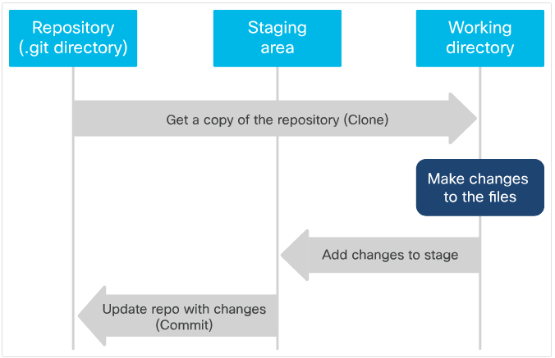
Git
Git is organized by 3s – Three Stages and Three States
Three Stages:
Repository: Contains the .git directory where the project history is stored.
Working Directory: Where you make changes to your files.
Staging Area: Intermediate area where changes are listed before committing to the repository.
Three States:
Committed: Data is securely stored in the local database.
Modified: Files have been changed but not yet committed to the database.
Staged: Modified files are marked and ready to be committed.

Slide 41
Git – Local e Repository
Local Repository:
Stored on the client machine where git commands are executed.
Allows full project manipulation including history, without affecting the remote repository.
Remote Repository:
Located elsewhere, typically on a server or repository hosting service.
Contains the complete repository: code and file history, maintaining the DVCS nature.
Fully independent of the local repository post-cloning or creation.
Interaction:
Cloning results in acquiring a full, independent local copy without needing locks, unlike CVCS.
Post-clone or creation, repositories remain independent until changes are manually pushed or pulled through Git commands.

Slide 42
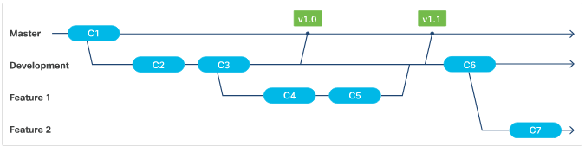
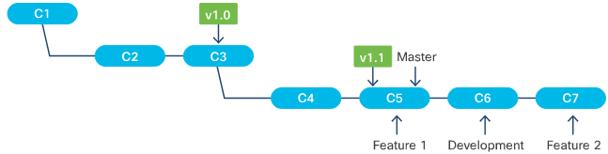
Git – Branches
Branching allows users to work on code independently without affecting the main repository.
Initially, the code is automatically placed on a branch called "Master“ or “Main”.
Types of Branches:
Can be local or remote.
Have their own history, staging area, and working directory.
Can be deleted as needed.
Git's Branching:
Lightweight and quick.
Switching between branches is nearly instantaneous, adjusting the code in the working directory and files in the staging area.
The repository (.git) directories remain consistent across different branches.

Slide 43
Git vs GitHub
Git vs GitHub:
Git: A distributed version control system providing a command-line interface.
GitHub: A service by Microsoft, implementing a repository hosting service using Git.
GitHub Features:
Offers all functionalities of Git.
Provides additional features like:
Code Review
Documentation
Project Management
Bug Tracking
Feature Requests
Pull Request:
Introduced by GitHub.
A formalized method for contributors to request a review of changes in their branch for inclusion in the main or other curated branches.

Slide 44
Coding Basics

Slide 45
Clean Code
Clean Code: Clean code is a concept in software development that emphasizes writing code in a readable and maintainable manner. It involves:
Readability: The code should be easy to read and understand by others, not just the original author.
Simplicity: Avoiding unnecessary complexity and focusing on simplicity.
Consistency: Following a consistent coding style and adhering to project guidelines.
Documentation: Providing clear comments and documentation to explain the purpose and functionality of the code.
Testing: Writing tests to ensure the code works as intended and to prevent regressions.
By adhering to the principles of clean code, developers can reduce bugs, enhance collaboration, and maintain code more effectively.

Slide 46
Clean Code
Clean code is the outcome of developers striving to make their code easily readable and understandable for others. It adheres to several guiding principles:
Formatting & Organization: Ensuring consistent layout and structuring of the code.
Intuitiveness: Making components straightforward and logical.
Purpose & Reusability: Writing code with clear objectives and potential for reuse.
Self-Documenting: Using inline comments and meaningful names to explain the code.
Modularity & Standardization: Creating modular, standardized code for easier testing and maintenance.
Why Write Clean Code? Developers aim for clean code for several reasons:
Understandability: Clean code is easier to read, comprehend, and work on.
Testability: Its modularity facilitates automated testing, like unit testing.
Maintainability: Standardization and organization make it simpler to maintain.
Aesthetics: Well, it simply looks nicer and is more satisfying to work with!

Slide 47
Functions, Methods, Classes and Modules
As projects evolve in size and complexity, and as more developers and stakeholders become involved, disciplined methods and best practices become crucial. These practices are essential to enable developers to write better, more maintainable code, and to facilitate collaboration.
Why Emphasize on These Elements?
Enhanced Collaboration: Structured code makes it easier for teams to read, understand, and work together.
Maintainability: Modular and organized code is simpler to update, debug, and maintain.
Scalability: Adopting best practices from the start facilitates the scalability of the project as it grows.
In conclusion, integrating methods, functions, modules, and classes in coding practices is essential in addressing the challenges posed by evolving project requirements and diverse development teams. These elements, along with adherence to best practices, pave the way for successful, maintainable, and scalable software development.

Slide 48
Functions, Methods, Classes and Modules
Functions
Purpose: Functions are blocks of reusable code that perform a specific task, improving modularity and readability.
Benefits: They reduce redundancy, enhance readability, and enable easier maintenance and updates.
Methods
Purpose: Methods are functions defined inside the context of a class. They are used to define the behaviors of an object.
Benefits: They provide a way of reusing code and can be overridden or extended in subclasses, promoting modularity and object-oriented design.
Classes
Purpose: Classes are the foundation of object-oriented programming. They encapsulate data and the methods that operate on that data.
Benefits: They foster encapsulation, inheritance, and polymorphism, contributing to code organization and reusability.
Modules
Purpose: Modules are files containing Python statements and definitions. They allow for the logical organization of functions, variables, and classes.
Benefits: They promote code reuse, namespace partitioning, and collaborative development.

Slide 49
Functions and Methods
Functions and methods are essential building blocks in programming.
They encapsulate blocks of code to perform specific tasks.
Below are some best practices to decide whether a code segment should be encapsulated within a method or function:
Discrete Task: Any piece of code that performs a specific, distinct task can be considered for encapsulation, even if it’s used only once. This approach can enhance code readability and maintainability.
Reuse: Code that is reused in different parts of a program should be encapsulated to avoid redundancy and make the codebase more manageable and less prone to errors.
Methods and Functions can be written once and executed as many times as required.
Essential for writing clean and maintainable code.

Slide 50
Functions and Methods
# Define the function
def function_name(parameters):
"""
Docstring explaining the function.
"""
# You can use the parameters just like local variables
# Code block
return result

Slide 51
Arguments and Parameters
Arguments and parameters are fundamental in adding flexibility and versatility to methods and functions.
They enable the functions to process different inputs, thereby allowing more reusability and adaptability of your code.
How they work:
Parameters act as placeholders within the function definition.
Arguments are the actual values that are passed into the function when it is called.
By leveraging arguments and parameters, you can write more dynamic and modular code, enhancing the efficiency and maintainability of your programming projects.

Slide 52
Return Statements
The return statement is a pivotal component in functions, signifying the end of the function's execution and passing control back to the calling function. It is defined using the keyword return, followed by a variable or expression representing the value to be returned.
How it Works:
When a return statement is executed, the function's execution is terminated.
The value specified in the return statement is passed back to the calling function.
Any code following the return statement within the function is skipped and not executed.
Understanding and effectively utilizing return statements are crucial for managing the flow of your code and retrieving results from your functions.

Slide 53
Arguments, Parameters and Return
# Define the function
def function_name(parameter1, parameter2, ...):
"""
Docstring explaining the function.
"""
# You can use the parameters just like local variables
# Code block
return result
# Call the function
function_name("argument1", {"argument2": "2"}, ...)

Slide 54
Functions vs. Methods
Functions | Methods
Functions are standalone code blocks that perform a specific task. | Methods are code blocks that are associated with an object.
They are not tied to a specific object and can be used independently. | They are utilized in object-oriented programming to perform operations using object data

Slide 55
Classes
In Python, as in many OOP languages, classes are a means of bundling data and functionality together, creating a new object type with each declaration. Classes are blueprints for creating objects.
Classes contain attributes – characteristics - and methods – actions - to define objects.
Classes can be instantiated multiple times, with each instance having its own specific data attribute values.
New classes can be defined based on existing ones, inheriting their properties, data members, and methods.
Note: In Python, there is no built-in way to make class variables or methods private. However, by convention, names with a single preceding underscore (_) are considered private and should not be accessed outside the class.

Slide 56
Classes
# Define the Class
class FunctionContainer:
"""
A class that contains the function_name method.
"""
@staticmethod
def function_name(parameter1, parameter2, ...):
"""
Docstring explaining the function.
"""
# You can use the parameters just like local variables
# Code block
return result
# Call the function
FunctionContainer.function_name("argument1", {"argument2": "2"}, ...)

Slide 57
Modules
Developers use modules to break down a large project into smaller, more manageable parts, enhancing readability and understandability.
Modules consist of a set of functions, variables, and classes. They usually provide an interface for interaction and integration with other modules.
A module is packaged as a single file and is designed to operate independently.

Slide 58
Modules
# File: FunctionContainerModule.py
# Define the Class
class FunctionContainer:
"""
A class that contains the function_name method.
"""
@staticmethod
def function_name(parameter1, parameter2, ...):
"""
Docstring explaining the function.
"""
# You can use the parameters just like local variables
# Code block
return result

Slide 59
Modules
# Main Code File
# Importing FunctionContainerModule
import FunctionContainerModule
# Using function from the module
FunctionContainerModule.FunctionContainer.function_name("argument1", {"argument2": "2"}, ...)

Slide 60
Code Review and Testing

Slide 61
What is a Code Review?
A code review is a systematic examination of computer-source code. It is conducted to improve the quality of the codebase and foster a collaborative environment. During this process, developers - often termed as reviewers - meticulously go through a subset of the code or specific changes, providing valuable feedback.
Why Should You Conduct Code Reviews?
Quality Assurance: Ensures that the final code adheres to best practices, is free of bugs, and uses correct formatting.
Readability & Maintainability: Confirms that the code is easy to read, understand, and maintain.
Collaboration & Knowledge Sharing: Fosters team collaboration and helps in sharing knowledge about different parts of the codebase.
Documentation & Commenting: Verifies that the code is well-documented and contains appropriate comments, aiding future development.
The code review process is typically initiated after the code changes have been completed and tested, ensuring that the final version is of the highest quality.

Slide 62
Types of Code Review
There are several types of code review processes, each with its unique approach and purpose. Below are the most common types:
Formal Code Review: Developers hold a series of meetings to review the entire codebase.
Purpose: Comprehensive examination for high assurance of code quality.
Change-based Code Review, also Known as Tool-assisted Code Review: Focuses on reviewing code changes made due to a bug, user story, feature, commit, etc.
Purpose: Ensures quality and correctness of new or modified code.
Over-the-Shoulder Code Review: A reviewer physically looks over the shoulder of the developer who wrote the code and provides immediate feedback.
Purpose: Quick and informal review for instant feedback and correction.
Email Pass-Around: Conducted following the automatic emails sent by source code management systems upon a check-in.
Purpose: Allows for asynchronous review of code changes by multiple team members.

Slide 63
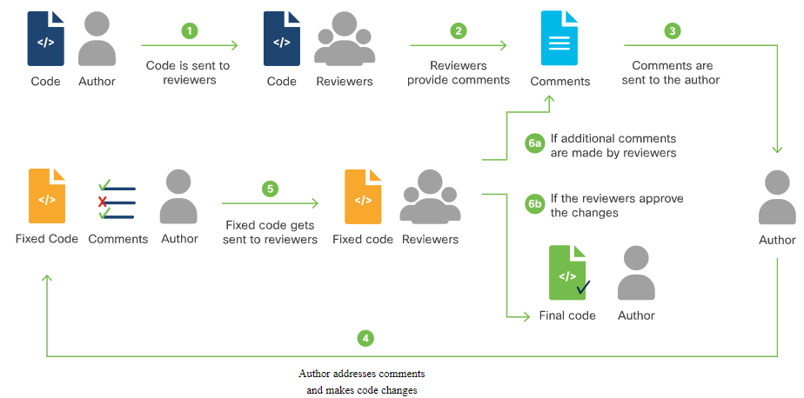
Code Review

Slide 64
Testing - Unit Testing
Unit Testing is a level of software testing where individual units or components of a software are tested in isolation. The purpose is to validate that each unit of the software code performs as designed.
Unit testing involves testing small, isolated pieces of code, such as lines, blocks, functions, and classes
Purpose:
Validate that individual units or components function as intended.
Identify and fix bugs at an early stage.
Facilitate code refactoring and ensure code reliability.
Python offers several frameworks to facilitate Unit Testing, each with its unique features and syntax.

Slide 65
Python Test Frameworks
PyTest | unittest
Automatic Execution: Executes scripts starting with test_ or ending with _test.py and functions beginning with test_ or tests_ | Requires subclassing the built-in TestCase class and overriding or adding new methods with names beginning with test_.
Ease of Use: Simply copy the code into a file, import PyTest, add testing functions, save under an appropriate filename, and run with PyTest. | Built-in Methods: Offers various built-in methods for asserting and testing conditions

Slide 66
Integration Testing
Integration testing is a level of software testing where individual units are combined and tested as a group. It aims to expose faults in the interaction between integrated components. The main goal is to ensure that all the individual units fit together properly to make a complete application.
PyTest can be used for conducting integration tests in Python.
Running the code with PyTest produces an output which indicates whether the tests have passed or failed, along with detailed information on any discrepancies.
Additional Notes:
Integration testing is crucial for identifying interface issues between modules or units.
It helps in verifying the functional, performance, and reliability requirements placed on major design items.

Slide 67
Test-Driven Development (TDD)
Test-Driven Development (TDD) is a software development approach where tests are written before the actual code. It helps in validating whether the application design aligns with the requirements. Here’s how it works:
Write a Test: Start by writing a test that defines a function or improvements of a function.
Run All Tests: Ensure that the new test fails initially, confirming that the existing application logic does not meet the new requirements.
Write Application Code: Develop code to pass the newly added test. Keep the code as simple as possible to make the test pass.
Re-run Tests: Run all the tests again to check if any fail. If they do, update the application code.
Refactor Code: Clean up and optimize the code while keeping it functional and maintainable.
By iterating through these steps, TDD ensures that the codebase is robust, meets the requirements, and remains easy to maintain. The cycle repeats with each new functionality until the application is fully developed.

Slide 68
Understanding Data Formats

Slide 69
Understanding Data Formats
Data formats are structured ways of representing and organizing information, allowing for efficient:
Storage
Transmission
Interpretation
They play a crucial role in ensuring that data is accurately and consistently understood across different platforms and applications.
Using data formats with REST APIs enables the exchange of information between services and devices, utilizing various standard formats. The most used data formats are XML, JSON, and YAML.

Slide 70
Data Formats and APIs
Parsing XML, JSON, or YAML is a common necessity when interacting with APIs. A frequently observed pattern in implementing REST APIs includes the following steps:
Authentication:
Initiate by POSTing user/password.
Retrieve an expiring token for subsequent requests.
GET Request:
Execute a GET request to retrieve the resource state.
Request output in XML, JSON, or YAML format.
Modify Data:
Alter the retrieved XML, JSON, or YAML data as necessary.
POST/PUT Request:
Execute a POST (or PUT) to modify the resource state.
Request and interpret output in XML, JSON, or YAML to confirm the operation's success.
Understanding both data formats and how to parse XML, JSON, or YAML are essential for effectively interacting with REST APIs and ensuring seamless communication between different services and devices.

Slide 71
XML
Extensible Markup Language (XML) is a method for wrapping textual data in symmetrical tags to indicate semantics.
Derived from Structured, Generalized Markup Language (SGML) ad parent of HyperText Markup Language (HTML).
XML Filenames typically end in ".xml".
<?xml version="1.0" encoding="UTF-8"?>
<!DOCTYPE network SYSTEM "example.dtd">
<network xmlns="http://www.example.com/example?param1=value1&amp;param2=value2">
<!-- Definition of a network -->
<router id="R1">
<hostname>Router1</hostname>
<interface>eth0</interface>
<ip_address>192.168.1.1</ip_address>
<subnet_mask>255.255.255.0</subnet_mask>
</router>
</network>

Slide 72
XML
Characteristics of XML Document:
XML Prologue: The initial section of an XML file, which includes the XML declaration and optionally the DOCTYPE declaration.
XML Document Body: The section of an XML document that follows the prologue. It contains the actual XML content and elements."
User-Defined Tag Names: Tag names are user-defined and should clearly express the meaning of data elements, their relationships, and hierarchy.
Special Character Encoding: Data is conveyed as readable text.
Comments in XML: Can include comments, similar to HTML documents.
XML Attributes: Allows embedding attributes within tags for additional information.

Slide 73
XML Namespaces
XML Namespaces are essential components defined by various entities such as the IETF and other internet authorities and organizations. They play a crucial role in avoiding name conflicts by uniquely identifying elements and attributes within XML documents, especially when they are integrated from different sources.
Key Characteristics of XML Namespaces:
Defined by Authorities: IETF, along with other internet authorities and organizations, define XML Namespaces, ensuring standardization and uniformity.
Publicly Hosted Schemas: The schemas for these namespaces are typically available as public documents on the web.
Identified by URIs: Each namespace is uniquely identified by a Uniform Resource Name (URI), which serves as a unique identifier rather than a location to be resolved.
Location Independence: The use of URIs ensures that the documents associated with a namespace are persistently reachable, eliminating concerns about their actual locations.

Slide 74
Interpreting XML
The XML structure is represented as a collection, akin to a list or one-dimensional array.
Within this collection, there are objects, akin to dictionary entries in Python. These objects in the XML example are denoted by the "router" tag.
Each object, or "router" entry, contains multiple key-value pairs. For instance, the "hostname" and "ip_address" are such pairs.
For those familiar with Python, this XML can be conceptually translated to a data structure. Consider the following semantically-equivalent Python data structure:

Slide 75
Interpreting XML
<?xml version="1.0" encoding="UTF-8"?>
<!DOCTYPE network SYSTEM "example.dtd">
<network xmlns="http://www.example.com/example?param1=value1&amp;param2=value2">
<!-- Definition of a network -->
<router id="R1">
<hostname>Router1</hostname>
<interface>eth0</interface>
<ip_address>192.168.1.1</ip_address>
<subnet_mask>255.255.255.0</subnet_mask>
</router>
</network>
network = [
{
'id': 'R1',
'hostname': 'Router1',
'interface': 'eth0',
'ip_address': '192.168.1.1',
'subnet_mask': '255.255.255.0'
}
]

Slide 76
JSON
JSON stands for JavaScript Object Notation and is inspired by the object literal notation of JavaScript.
Commonly used for transmitting data in web applications.
Filenames typically end with ".json".
{
"network": {
"@xmlns": "http://www.example.com/example?param1=value1&param2=value2",
"router": {
"@id": "R1",
"hostname": "Router1",
"interface": "eth0",
"ip_address": "192.168.1.1",
"subnet_mask": "255.255.255.0"
}
}
}

Slide 77
JSON
Basic Data Types: include numbers, strings, Booleans and nulls.
Objects: In JSON, individual objects comprise key/value pairs, surrounded by braces.
Example: {"key": "value"}
Maps and Lists: Each key/value pair in a JSON object doesn't require individual brackets, but the entire set of pairs does. JSON compound objects can be deeply nested, exhibiting complex structures.
Example: {"users": [{"name": "Alice"}, {"name": "Bob"}]}
No Comments: Unlike XML and YAML, JSON doesn't support standard methods for including unparsed comments in the code.
Whitespace: Whitespace in JSON is not significant. Files can be indented using tabs or spaces, or not at all, depending on preference.

Slide 78
YAML
YAML stands for "YAML Ain't Markup Language." It is designed for human readability and is a superset of JSON.
Given its nature as a superset, YAML parsers can typically parse JSON documents, but the reverse is not always true.
This makes YAML more versatile than JSON in some scenarios, including the ability to directly embed JSON within YAML files. YAML files typically have the file extension ".yaml" or ".yml".
network:
xmlns: "http://www.example.com/example?param1=value1&param2=value2"
router:
id: R1
hostname: Router1
interface: eth0
ip_address: 192.168.1.1
subnet_mask: 255.255.255.0

Slide 79
YAML
File Structure: YAML files conventionally open with three dashes (---) alone on a line and can optionally end with three dots (...).
Basic Data Types: Basic data types in YAML include numbers, strings, Booleans, and nulls.
Basic Objects: Called map, consisting of key-value pairs, where keys are associated with specific data types.
Indentation: YAML indicates its hierarchy using indentation, which is crucial for denoting structure.
Maps and Lists: YAML can represent more complex data types like maps and ordered lists.

Slide 80
YAML
Lists:
Lists are sequences of items.
Lists in YAML are indeed sequences of items and are represented by a series of lines.
Each line starting with a dash followed by a space, and then the item.
Lists in YAML can be represented without indentation, but it is a recommended practice to enhance readability.
network:
xmlns: "http://www.example.com/example?param1=value1&param2=value2"
router:
id: R1
hostname: Router1
interfaces:
- name: eth0
ip_address: 192.168.1.1
subnet_mask: 255.255.255.0
- name: eth1
ip_address: 192.168.1.2
subnet_mask: 255.255.255.0

Slide 81
YAML – Flow Syntax
YAML also supports a condensed form that looks more like JSON or Python dictionaries or lists. This is called "flow syntax".
Flow Syntax
In "flow syntax", we use {} to represent maps and [] to represent lists.
network: {
xmlns: "http://www.example.com/example?param1=value1&param2=value2"
router: {
id: R1
hostname: Router1
interfaces: [
{ name: eth0, ip_address: 192.168.1.1, subnet_mask: 255.255.255.0 },
{ name: eth1, ip_address: 192.168.1.2, subnet_mask: 255.255.255.0 }, ]
}
}

Slide 82
YAML – Long String
In YAML, strings can span multiple lines to represent long text or content.
Folded Style (>): Useful for multi-line strings where line breaks should be replaced with spaces.
Literal Block (|): Preserves newlines and all other formatting directly.
description: >
This is a folded string in YAML.
It continues over multiple lines,
but will be interpreted as a single
line with spaces when parsed.
nextKey: Value
anotherDescription: |
This is a literal block in YAML.
Newlines will be preserved here.
anotherKey: Another Value

Slide 83
YAML – Comments
Comments can be inserted anywhere in a YAML document except within a string literal.
They are preceded by the # sign, often followed by a space for readability.
YAML possesses numerous advanced features. These are often utilized in the context of specific programming languages, like Python, or when converting between YAML and other formats such as JSON.
YAML 1.2, for instance, supports schemas and tags. These tools can be used to refine the interpretation of values.
# This is a comment in YAML
key: value # This is an inline comment
# Interpret the following number as a string
anotherKey: !!str 12345

Slide 84
Parsing and Serializing
Parsing:
Involves breaking down a message or data string into its individual components.
Interprets the role and purpose of each component within the context.
Enables programs to understand and process the content of the message.
Serializing:
Essentially the reverse process of parsing.
Converts structured data or objects into a standardized format suitable for storage or transmission.
Ensures data consistency when sharing between different systems or saving to storage.
Implementation in Programming:
Languages like Python offer robust parsing functions to process data from I/O operations, producing structured and typed internal data representations.
They also provide user-friendly serializers that convert internal structures into formatted strings or messages suitable for external communication or storage.

Slide 85

Obrigado!

